Slide 1
Stories with Insight
August 12 2014

Slide 2
We are storytellers
Analytics is a profession of weaving stories from strands of data
Stories are a type of Mnemonic (or memory device) that links easily understood narratives to more complex ideas
Not only can we use stories to communicate with others but they can also teach us lessons about how we should perform as analysts

Slide 3
What can Five Blind Men teach us about perspective?
5 Blind Men examined an Elephant to determine what it was like.
One man grabs the leg and says “The elephant is like a pillar; strong and straight”
One man grabs the tail and says “The elephant is like a rope; loose and frayed”
One man grabs the tusk and says “The elephant is like a spear; pointed and fierce”
One man grabs the ear and says “The elephant is like a fan; wide and flexible”
One man touches the side and says “The elephant is like a wall; firm and broad”

Slide 4
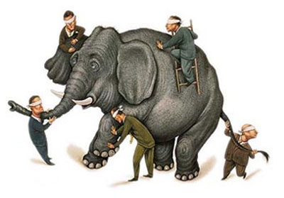

Slide 5
Lesson 1 : Perspective
"We have to remember that what we observe is not nature in itself, but nature exposed to our method of questioning." - Werner Heisenberg
We should not consider just one point of view.
What if we were trying to accuse someone of a crime; we would not believe the word of just one witness.
To a lesser extent; this is also a lesson in communication
Notes:
Werner Heisenberg – Known for the uncertainty principle which states that the more you know about the position of a particle the less you will know about its momentum and vice versa. German Theoretical Physicist who was a founder of quantum mechanics (mechanics on a very small scale).

Slide 6
The Rooster and the Diamond
One day; while a rooster was picking through a pile of straw looking for food,
it came upon a diamond. It picked up the diamond in its beak and threw it carelessly away. “What use have I for this shiny stone” it thought. “I would have treasured a kernel of corn even more.”

Slide 7
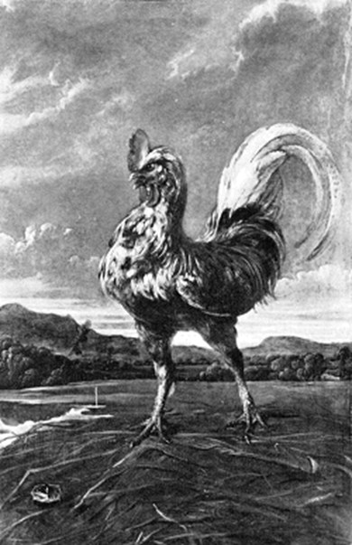

Slide 8
Lesson 2: The Value of Information
The value of information is determined by the needs of the observer.
Information has instrumental (not intrinsic) value
Careful what you discard; one man’s “useless stone” is another's diamond
Just because the insight is not useful to you; it may be valuable to someone else
What if the chicken would have known how valuable the diamond would be to a human? Would the chicken not have traded it for a whole load of corn?
It pays to know a little about other’s viewpoints
Notes:
Instrumental value (extrinsic value) is the value something has because it can be used to gain something of intrinsic value. Money has no intrinsic value; money has only instrumental value.
Intrinsic value can be found in family, friends, or self fulfillment.

Slide 9
For want of a horseshoe nail
A king was in a rush to get to a battle. He told the blacksmith that was shoeing his horse to hurry up. The blacksmith was lacking a final nail to secure the final shoe to the king’s horse. The king told the blacksmith that one nail would not make a difference; the king took the horse and went into battle.
During the battle the horse’s shoe came loose, the horse threw the king, and the king was killed by the enemy.

Slide 10
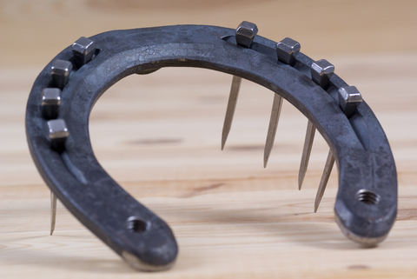

Slide 11
Lesson 3: Haste and Attention to Detail
For want of a nail, the shoe was lost;
For want of a shoe, the horse was lost;
For want of a horse, the king was lost;
For want of a king, the kingdom was lost—
All for the want of a horseshoe nail.
The details matter (99% correct is still wrong)
Slow down. Haste makes waste; waste makes mistakes; mistakes take time………. So haste takes time.
Haste denies all acts their dignity. - Dante Alighieri, The Divine Comedy
Notes:
Also, the error was no respecter of persons. The nail did not care that the king was a king. He could have been anybody. Mistakes are no respecter of persons; they can unseat a king or just cause a bad day for a peasant.

Slide 12
Football Players and Statistics
What do football players know about statistics? Not a lot.
What do football players know about football? Almost everything.
How do we teach a football player about stratified sampling?
If you do not currently know what stratified sampling is….. you should in just a minute.

Slide 13
From Football to A Stratified Sample
What if we wanted to know on average how fast a member of the football team is?
We could just randomly sample the whole team.
But what if our sample by chance only contained offensive linemen and no running backs? (Too Slow)
Or what if our sample contained only running backs? (Too Fast)
How could we make sure we sampled at least some running backs, some offensive linemen etc.
Maybe we could group the players by there position and then sample them?
This would create a stratified sample. (Groupings based on similar levels of a characteristic)

Slide 14
Lesson 4: Relational Learning
Explanation is made easier when we can relate new ideas (statistics) to ideas already established (football) in the audience’s (football player’s) mind
Try to see the explanation from the audience’s frame of reference
Seek to determine a common basis of understanding
Use accurate similes

Slide 15
Conclusions
Touch the elephant in more than one spot or talk to someone who has touched a different part
Rooster’s do not value diamonds and humans do not value corn
A small nail can cause the loss of a kingdom
Football players understand football (not statistics)

Slide 16
Quiz Question 1
What is the difference between Intrinsic and Instrumental Value?
Intrinsic Value means an object value resides in it’s existence.
Instrumental value means an object can be used to gain something that is intrinsically valuable

Slide 17
Quiz Question 2
What did we learn from the story of the elephant?
Look at situations from more than one perspective.

Slide 18
Quiz Question 3
What caused the king to lose his kingdom?
Just one horse shoe nail

